Slide 1
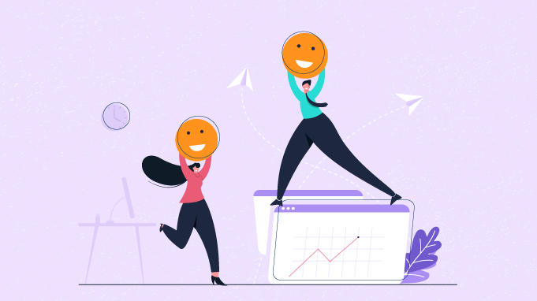
Chapter 13
Happiness and Success at Work

Slide 2
Why Happiness at Work Matters: Overview
Happy workers 10-20% more productive than unhappy (have better focus, problem-solving, creativity…think Fredrickson Broaden and Build)
Happiness boosts physical and mental health
  Chronic stress and unhappiness leads to burnout, anxiety, heart disease
  Happy employees have stronger immune systems
Happiness
  reduces turnover, increases loyalty
  enhances teamwork and collaboration
  Fuels organizational innovation
  Impacts the bottom line

Slide 3
Flip Side: Why Unhappiness at Work Matters
Burnout and disengagement cost U.S. companies over $300 billion annually (Gallup).
Toxic work environments can spread negativity, decrease morale, and damage reputations.

Slide 4
Why does happiness at work matter?
35% of 4,700 full and part-time employees in the US report being engaged with (committed to and enthusiastic about) their work
13% report being actively disengaged (miserable at work and spreading misery to others)
52% put their time in at work but not their passion or energy
Many people spend a huge amount of time working
If you worked from age 18 – 67, 39 hours/week, five weeks of vacation/year, you’d work 92,120 hours over your lifetime

Slide 5
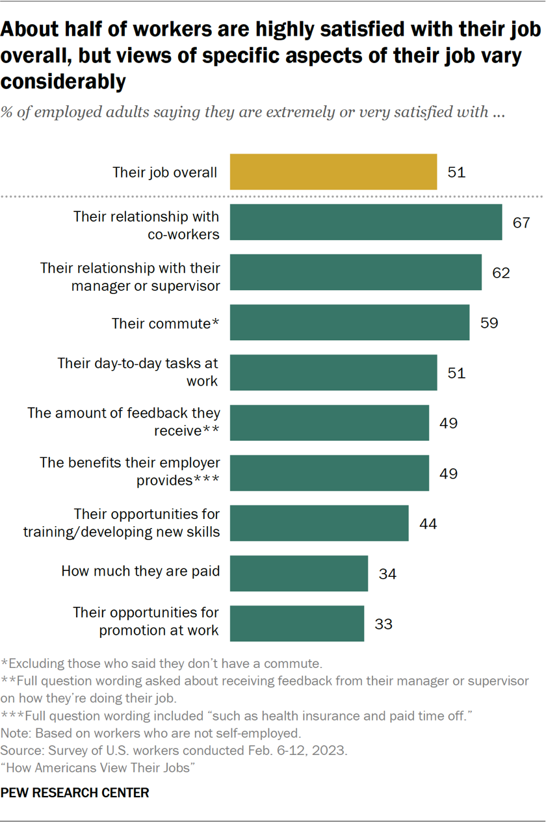

Slide 6
Employee Engagement
Positive, work-related state of mind, dedication, and absorption
Characterized by energy, involvement, and efficacy (which is opposite of job burnout elements of exhaustion, cynicism, inefficacy)
Differs from job satisfaction…both involve positive focus, but engagement goes beyond with involvement, absorption, dedication

Slide 7
What Promotes Engagement?
Positive emotionality disposition
  High…more enthusiastic, energetic, excited about job, report higher JS
  Zest, or approach life with anticipation, energy, excitement, a form of positive emotionality, predicts seeing work as calling and JS

Slide 8
What Promotes Engagement?
Positive emotions
  Helps enhance problem-solving and decision-making…flexible, creative, innovative problem solving
  Contributes to positive spontaneous behavior
  Think Fredrickson’s Broaden and Build Theory
  Enhances workplace achievement
    Positive moods…more sociable, less aggressive
    More likely to engage in OCBs

Slide 9
Explanations for Positive Emotions
Positive emotions linked with approach-oriented behaviors
More likely to enter novel situations, interact with others, pursue new goals
More engaged with work
Less burnout, less emotional exhaustion, less absenteeism, less turnover
More popular, gain more social support
Engage in more helpful behavior

Slide 10

What’s more important: Having more frequent positive emotions or more intense emotions?

Slide 11

Frequency of positive emotions more important than the intensity, because bursts (e.g., motivational seminar) are short lived, so need more frequent
Create work environments that induce positive emotions more consistently

Slide 12
Happiness and Employment Success
Strong correlation between happiness and employment success
Happier people:
Higher job satisfaction
Better performance evaluations from supervisors
Better retention in jobs
Fewer sick days
Less burn-out
Higher income

Slide 13
Positive Affect Predicts Goal-Setting and Intensity of Job Search
Which Predicts Job Interviews and Offers

Slide 14
Happiness Prospectively Predicts Job Outcomes
In a sample of 156 racially, ethnically, and socio-economically diverse 7th and 8th graders from the Southeastern US
Positive affect at age 14 predicted job satisfaction and self-reported job competence at age 25
In a sample of first year college students (N = 13,676) at 25 colleges and universities in the US
Participant rated cheerfulness at age 19 associated with income at age 37
Moderated by parental income at age 19: association strongest at “high” parental income

Slide 15
Journal Entry #22
Design a Happy Workplace
Pretend you are a Well-Being Consultant Team hired to improve happiness at work
3 Areas to Improve
Positive emotions: How can you increase daily joy, appreciation, or fun at work?
Engagement and Purpose: How can employees feel more connected to meaningful work?
Relationships and Culture: What can be done to build trust, support and teamwork?

Slide 16

Job, Career, Calling
Job – way to make money
Means to an end
Enjoyment of life outside of work prioritized
Career – potential for advancement at work
Gains and promotions are personally meaningful
Opportunities to gain prestige, power, and prove oneself
Calling – work is inseparable from the person
Work reflects values, passion, and meaning
Can be in any type of work

Slide 17
When Work is a Calling
Perceiving a calling – having the experience that you are “meant” to do a certain type of work
Living a calling – finding or creating an opportunity within one’s work to access purpose or meaning or contribute to the greater good
Perceiving a calling and living a calling correlated about r = .50

Slide 18
It’s not just a job, it’s a calling
Calling…related to individual success, resilience, and job satisfaction
Features of calling
  Action orientation (emphasis on doing)
  Clarity of purpose, direction, meaning, personal mission
  Prosocial intention (desire to make world a better place)
Notes:
Three views of occupation and explanation: Job, calling, career. Job focuses on the financial gains from work and on the necessity of work and earning a living. Career is a way to facilitate achievement motivation, stimulate their need for competition, or enhance prestige and satisfaction. Calling is a source of personal fulfillment; for many, this sense of fulfillment and meaning came from recognizing or simply believing that what they did had a socially useful purpose.
Features of calling:
Action-orientation, that is, an emphasis on doing rather than simply being. Specifically, a calling refers to a course of action, an activity to be done.
Sense of clarity of purpose, direction, meaning, and personal mission.
Prosocial intention, that is, a desire to make the world a better place.
People who regard their work as calling reap benefits: More focused career decision-making, higher motivation, increased job satisfaction, lower stress and frustration, stronger organizational commitment, and better organizational citizenship behavior.

Slide 19
It’s not just a job, it’s a calling
People who regard their work as calling reap benefits
  Focused career decision making
  Higher motivation
  Increased job satisfaction
  Lower stress and frustration
  Stronger organizational commitment
  Better organizational citizenship behavior
Potential Downside: challenge to balance passion for work with family, social, and leisure activities
Notes:
Three views of occupation and explanation: Job, calling, career. Job focuses on the financial gains from work and on the necessity of work and earning a living. Career is a way to facilitate achievement motivation, stimulate their need for competition, or enhance prestige and satisfaction. Calling is a source of personal fulfillment; for many, this sense of fulfillment and meaning came from recognizing or simply believing that what they did had a socially useful purpose.
Features of calling:
Action-orientation, that is, an emphasis on doing rather than simply being. Specifically, a calling refers to a course of action, an activity to be done.
Sense of clarity of purpose, direction, meaning, and personal mission.
Prosocial intention, that is, a desire to make the world a better place.
People who regard their work as calling reap benefits: More focused career decision-making, higher motivation, increased job satisfaction, lower stress and frustration, stronger organizational commitment, and better organizational citizenship behavior.

Slide 20
Prosocial Motives in the Workplace
Underlying reasons for being prosocial in the workplace
Desire to help other people
May have multiple motives in action at a given moment
Can be simultaneously self-motivated and other-motivated

Slide 21
Prosocial Behaviors
Organizational Citizenship Behaviors (OCBs) – voluntary behaviors that demonstrate a worker’s commitment and loyalty that fall outside of contractual obligations
OCBs overlap with but are not redundant with prosocial behaviors at work
  Mentoring - prosocial but not OCB
  Loyal to company – OCB but not prosocial
  Helping co-worker with a work task – prosocial & OCB

Slide 22
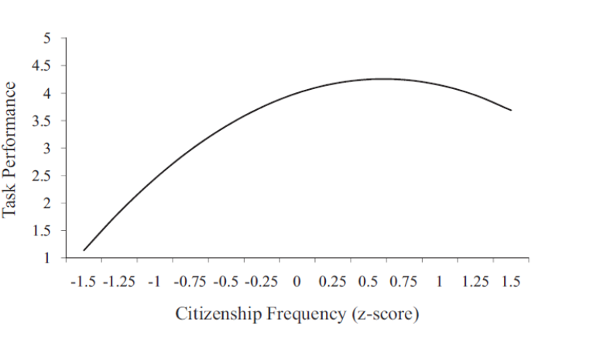
Association between Frequency of Prosocial Behavior and Performance

Slide 23
Prosocial Impact
Perception that your work has a positive impact on others
Acknowledge the ways in which your work makes the lives of other people better
Participants assigned to think about societal impact of their jobs reported lower negative affect and intention to quit, and higher positive affect and willingness to recommend job to others compared to those asked to think about the positive impression of their jobs

Slide 24

Employers can make the job better: Demonstrate Trust in Workers
Let My People Go Surfing – Patagonia
Autonomy – experience of choice and control in one’s work – is associated with:
  More professional satisfaction
  Less burn-out
  More commitment to work
Bowles theorized that policies meant to increase control over employees result in less intrinsic motivation to engage in work

Slide 25
Employers can make the job better: Provide Opportunities that Match Strengths
Peter Principle:
  In hierarchical organizations, people are promoted to their level of incompetence where they stay for the rest of their career
  Example: Performance in sales predicted promotion to managerial positions even though performance in sales was negatively correlated with performance in management
Solutions:
  Match strengths to requirements of position
  Reward people in positions in which they excel

Slide 26
Employees can make the job better: Job Crafting
Focus on making the perfect job instead of finding the perfect job
Making job fit with one’s skills, goals, and values
Job Crafting associated with:
Job satisfaction
More meaning in work
Perception that job requires skillful behavior
Can involve:
Changing boundaries of position – add/subtract tasks
Changing relational aspects of work
Thinking about job differently

Slide 27
Employees can make the job better: Make Social Connections
Having a friend at work (especially for women) is associated with:
More engagement at work
More positive and negative experiences at work
More risks that could lead to innovation
Higher retention
Occupational self-esteem
Life and job satisfaction
Positive affect
When randomized to interdependent or independent work groups, those in interdependent groups more likely to form a friendship tie

Slide 28
Culture and Perspectives on Work
Work-Family Conflict (WFC) – degree to which commitments and experiences at work disrupt family life and commitments in family life disrupt work
Association between (higher) WFC and (lower) life satisfaction is weaker in collectivistic cultures
Relative Centrality of Work (RCW) – degree to which work outcomes are a central focus on one’s life
Cross-cultural differences in RCW
Participants in US 2x as likely as any other country to report they would stop working if they won the lottery

Slide 29
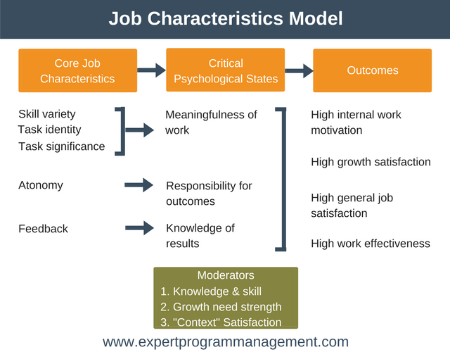
Work Motivation and Job Satisfaction

Slide 30
Transformational Leadership
How are transformational leaders effective?
Leaders posses a vision that is discrepant from the status quo, resonates with followers
Leaders have optimism and excitement about future
Leaders value individuals for unique talents and seek to maximize their self-actualization
High in dedication and hard work
High integrity
Provide clear directives and specific feedback
Possess charisma

